Slide 1
跟着Kevin学英语(3)
认识字母表
D M L T S B N W

Slide 2
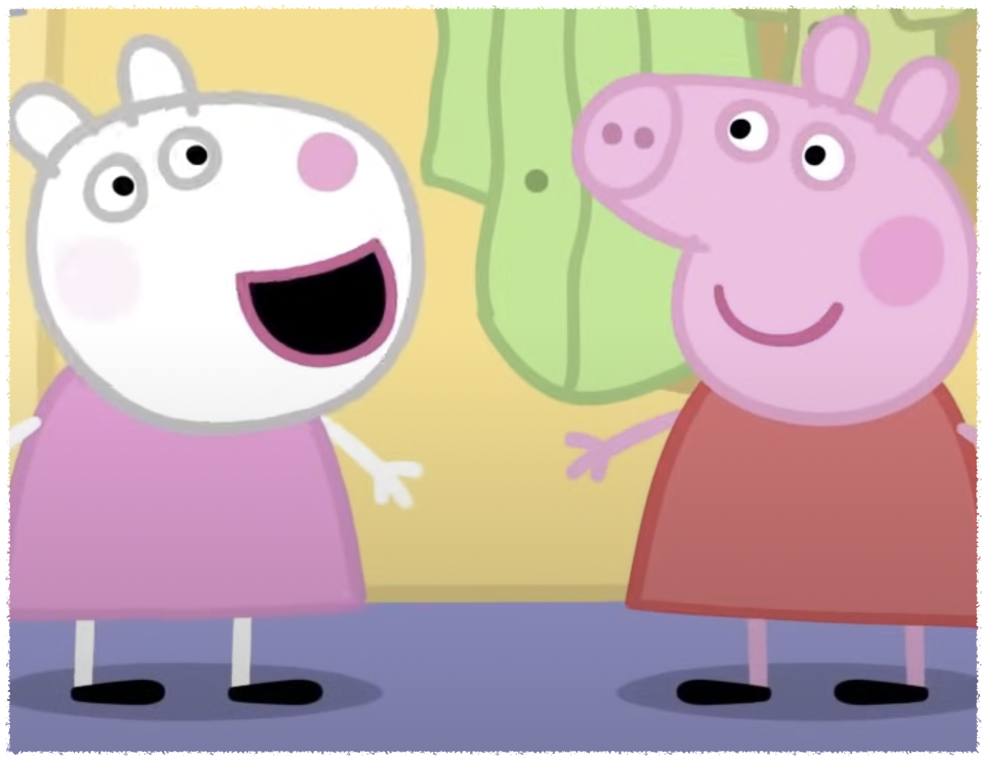
F f
Friend
Notes:
We are best friends

Slide 3
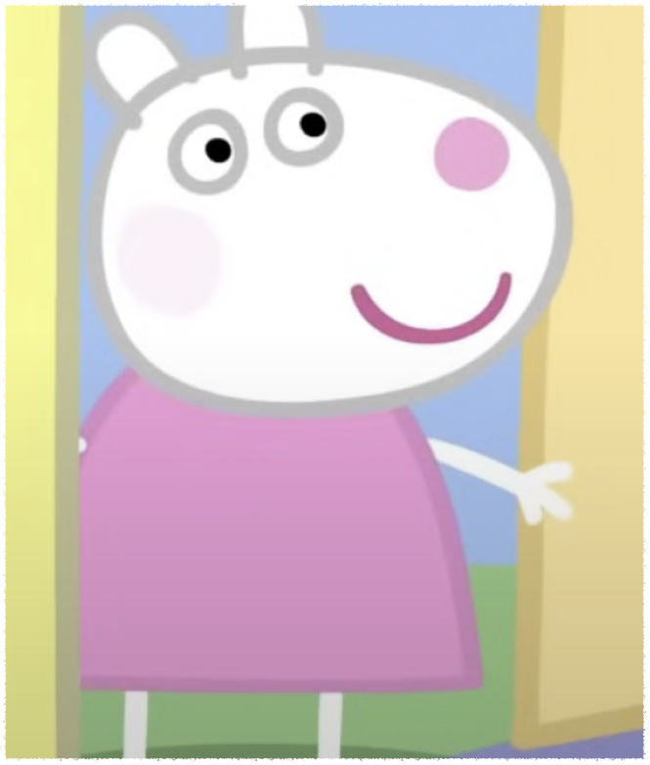
S s
Sheep
Notes:
Peppa is waiting for her best friend Susie Sheep

Slide 4
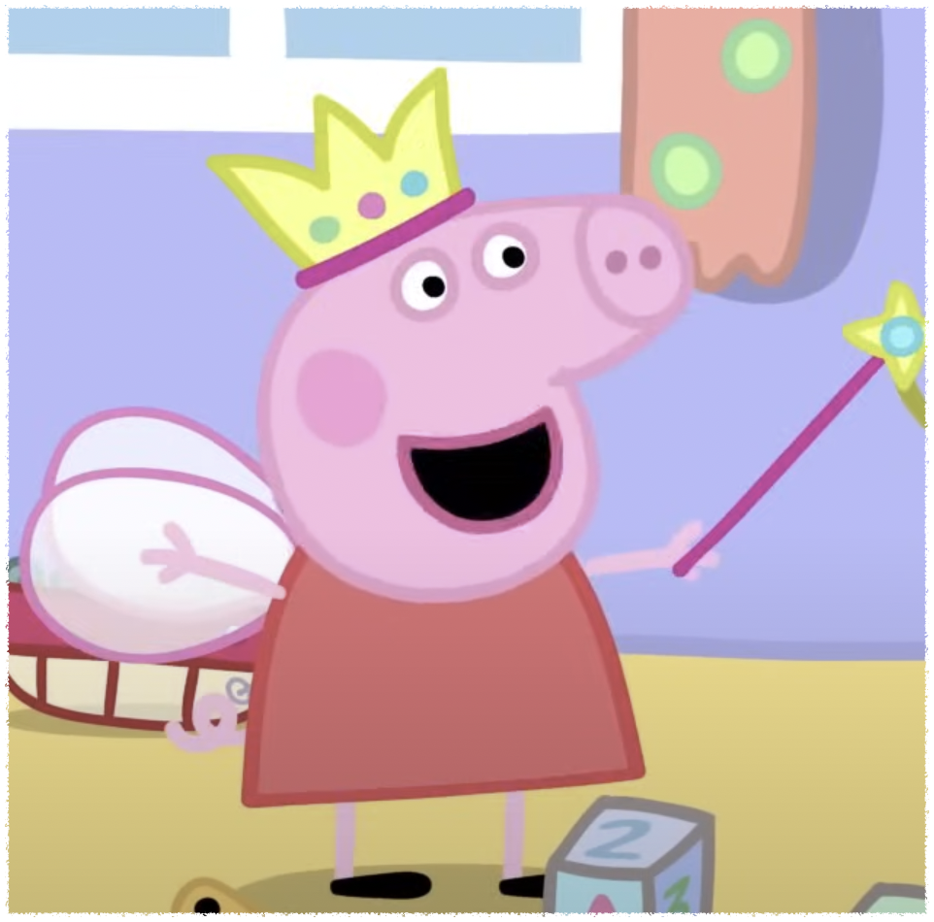
P p
Princess
Play
Notes:
Im a tiny little fairy princess

Slide 5
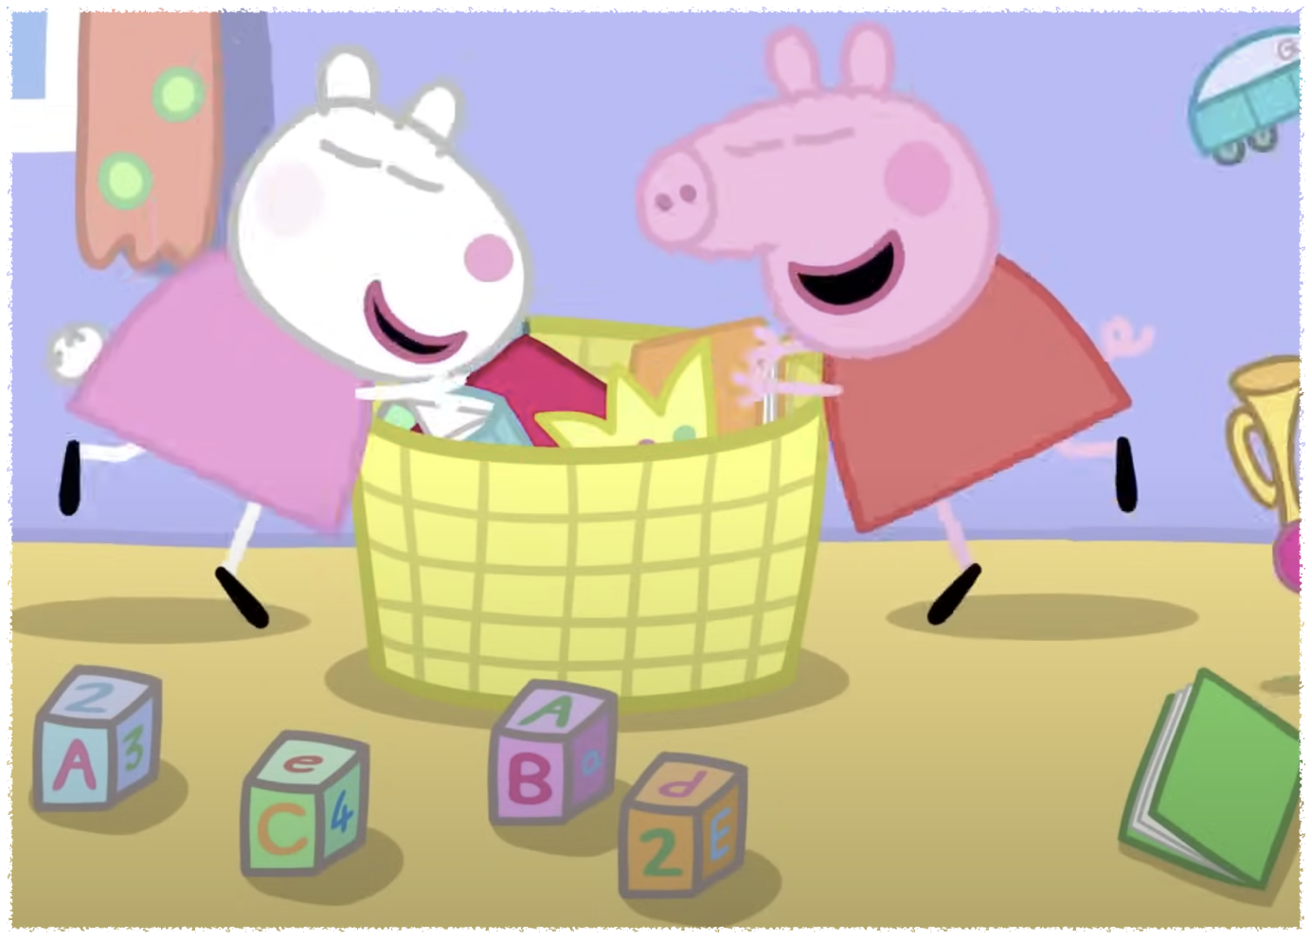
P p
Princess
Play
Notes:
I want to play with you

Slide 6
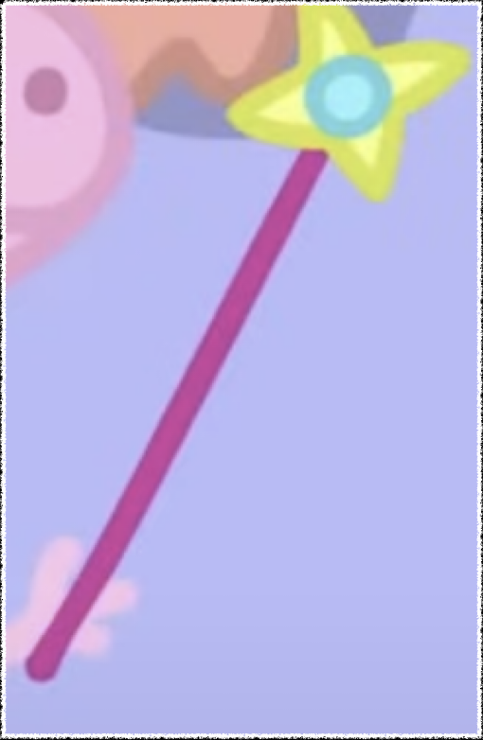
W w
Wand
Notes:
Im going to wave my magic wand

Slide 7
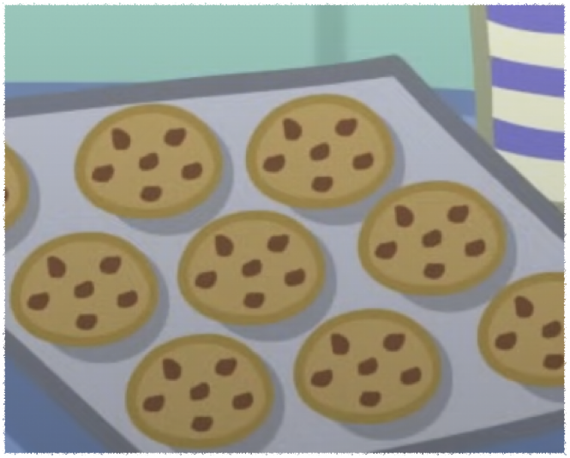
C c
Cookie
Notes:
George likes cookies

Slide 8
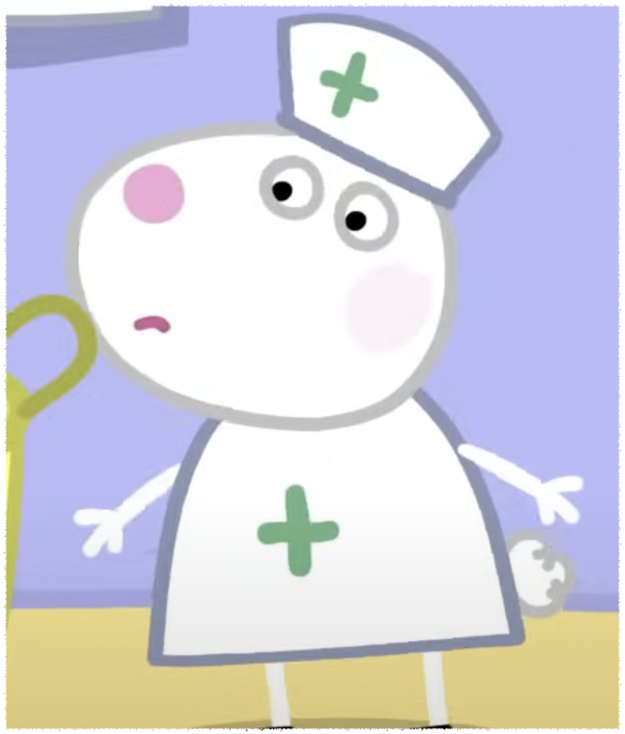
N n
Nurse
Notes:
I want to be a nurse

Slide 9
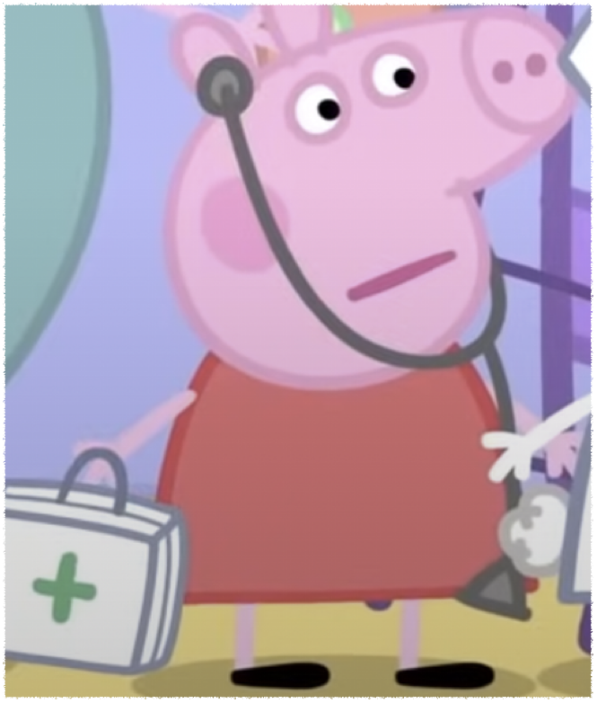
D d
Doctor
Notes:
I want to be a doctor

Slide 10
Excuse me
You are my best friend
I want to play with you I don’t like it
Notes:
George’s favorite toy is Mr dinosaur

